Slide 1
Navigating the challenges of integrating new industrial dischargers into your POTW
Jesse Neyens
Regulatory Compliance Manager

Slide 2
What is Pretreatment?
The Objectives are:
  prevent the introduction of pollutants into a POTW that will interfere with its operation, including with its use or disposal of municipal sludge
  prevent the introduction of pollutants into a POTW that will the treatment works or otherwise be incompatible with it.
The City of Sioux Falls is an approved Pretreatment Program by the SDDANR and we enforce federal and local regulations on “Significant Industrial Users”
Regulated through 40 CFR 403

Slide 3
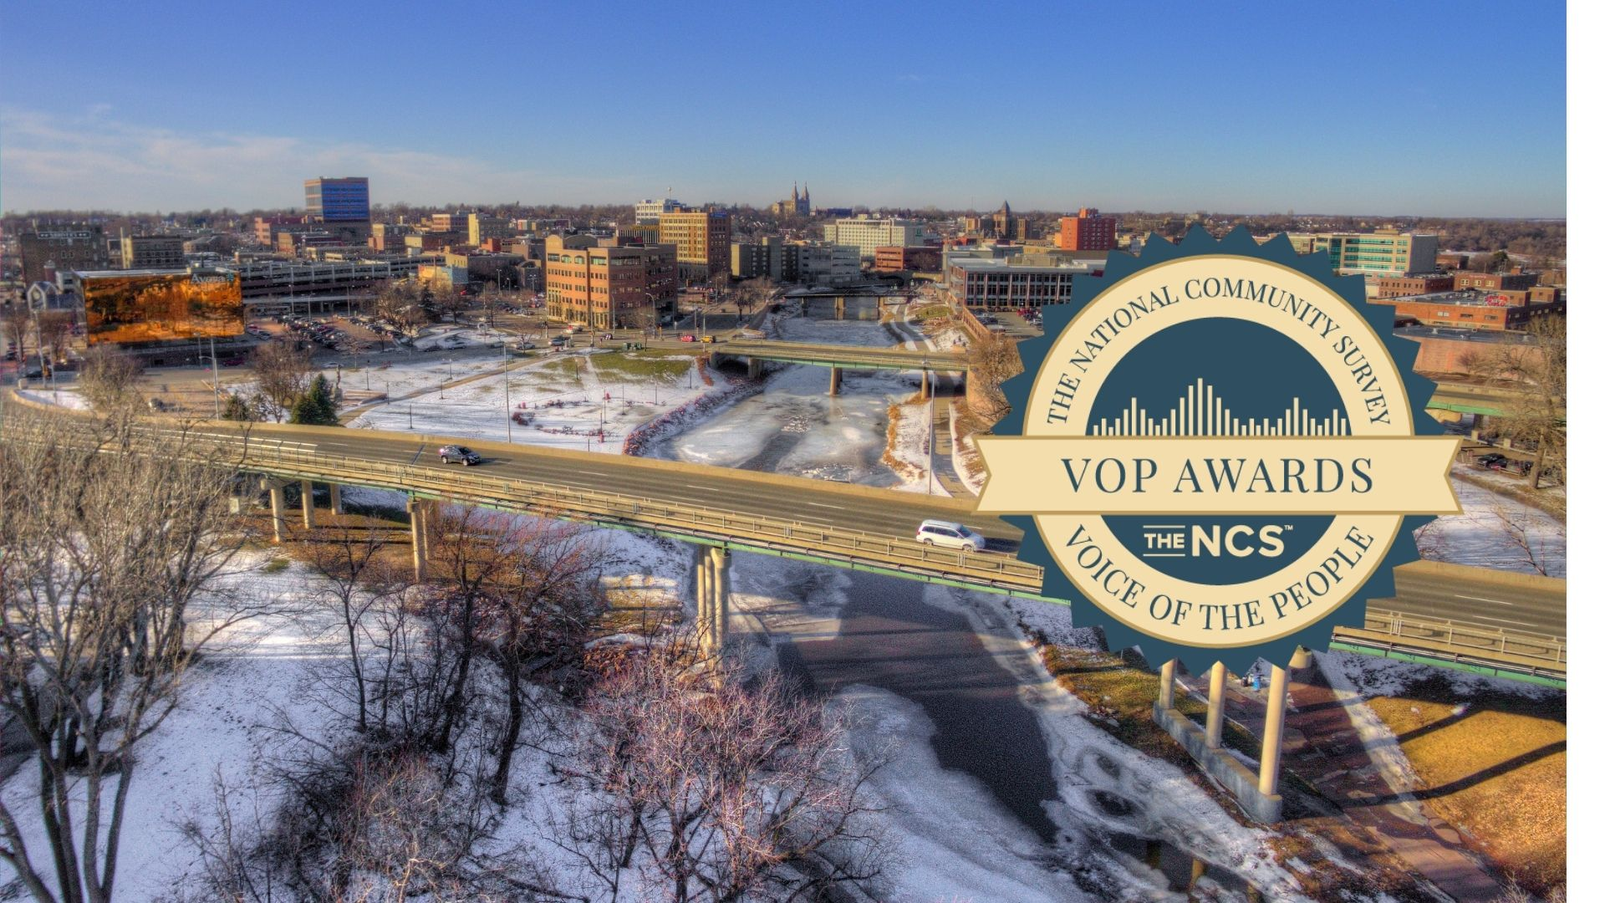
What does a Large Industrial User look for in locating in your service area?
Land
Water
Wastewater
Electricity
Roads
Workforce
Low Taxes
The best deals they can get….

Slide 4
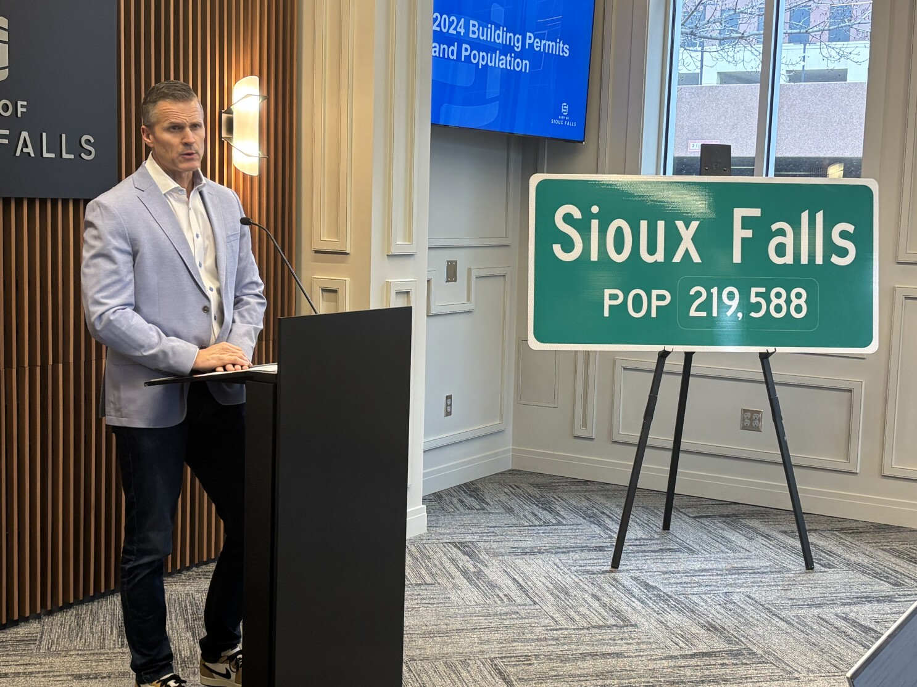
What Seems to be the Process of larger Industrial User coming to your town.
Usually, this user is in contact with the State of SD Economic Development Office or potentially local Economic Development Office.
  In Sioux Falls we have the Sioux Falls Development Foundation (Foundation Park)
Then your City Administration (Mayor, Directors, etc.)
Then possibly City Engineers, some upper-level staff.

Slide 5

What Seems to be the Process of larger Industrial User coming to your town cont…
Then….. The process seems to stop here at times why? These industrial customers want to stay secret, possibly sign an NDA.
  Project J
  Project Cardinal
  Project Juniper
  Project mockingbird

Slide 6
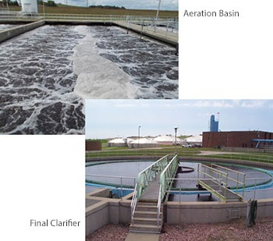
Who doesn’t get notified?
Who is most knowledgeable about your wastewater system?
Wastewater Facility Personal!

Slide 7
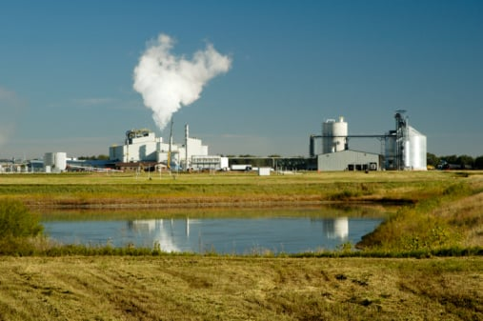
What’s the Problem?
These facilities may have pollutants in their wastewater that could cause an upset or passthrough in your system.
Facilities may be Food Processing
Metal Finishing
Slaughterhouses
Agriculture Related
Notes:
For the most part (food processing)

Slide 8
Facilities
Food Processing and Ag related can have high levels of:
  BOD (Biochemical Oxygen Demand)
  TSS (Total Suspended Solids)
  Nitrogen Compounds
  pH variabilities
  Flow
  Chlorides, sulfates etc.…
Metal Finishers
  Heavy metal Compounds
  Cyanide
  Volatile Organic Compounds

Slide 9
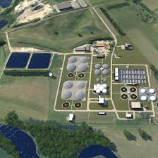
What can you do?
First you need to fully understand the capacity and capabilities of your treatment facility including:
Max Flows and Loadings
Current Flows and Loadings
How much capacity you may want to reserve for future growth
Cost of future Expansion
Notes:
Talk about 15 year capacity and 20% could be gone with 1 industry.

Slide 10

Cont….
Educate your decisionmakers
Educate the Economic Development people
Beg to get involved
  Just because you have capacity doesn’t mean you can handle the wastewater.

Slide 11

Administration Education
Look at how this impacts the Wastewater Treatment Facilities Financials (not just how much money they will pay in user fees)
  Expansion
  Value of Capacity
  Cost to Customers
  Collection System Problems
  We did not build additional industrial capacity into our Master Plan
Notes:
20 million for 1MDG of flow.

Slide 12
Industries
You have to ask for the details
  Flows – Max, Minimum, Average, Continuous, Batch.
  Loadings- What is their process? What are the expected concentrations of pollutants in their wastewater. Be Specific!
  Treatment – are they providing any, what is it.
  Get Everything in writing!
They never want to treat their own wastewater
They want to get the best deal possible
They want to give you as little information possible to make a decision on their wastewater discharge. They will hold you to it!

Slide 13
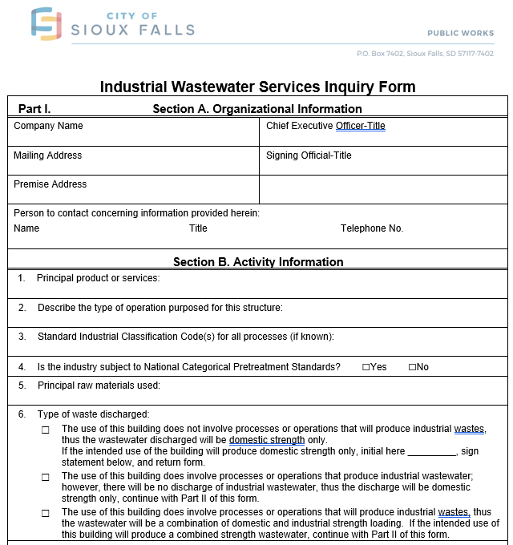
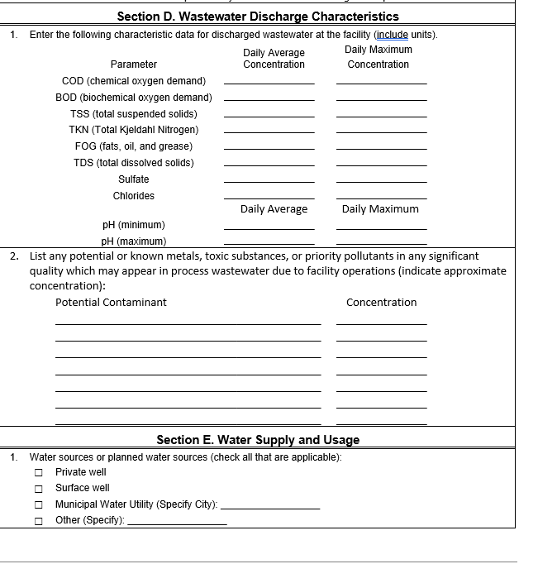
Our Process: Inquiry Form
Notes:
The First thing you need to do is stress how important wastewater is and get involved as early as you can. You have to educate your administrators and possibly even outside organizations on what your facility can handle and what are the costs and RISK.

Slide 14
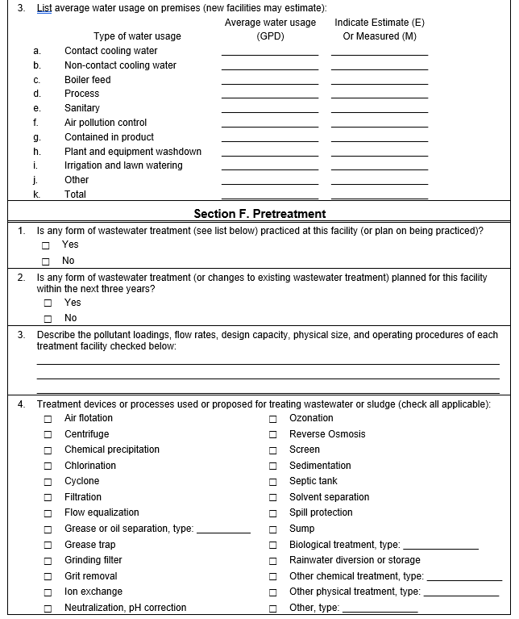
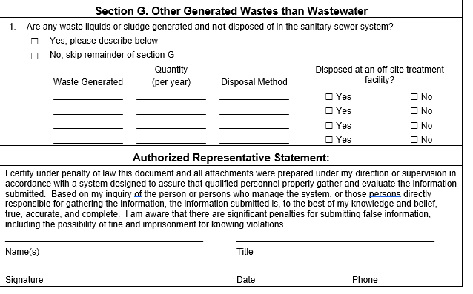
Process cont….

Slide 15
Where are we at?
For the most part any significant industry must treat their wastewater to domestic strength levels (still can have flow problems).
We try to help facilities problem solve their own wastewater issues.
  Make them do a cost analysis
They might be better off treating and discharging on their own through SDDANR Permit

Slide 16
QUESTIONS?

