Slide 1

Best Practices-Sampling and Impact on Laboratory Analysis
Energy Laboratories, Inc.
Amanda Carlson

Slide 2

Who We Are
A full-service laboratory providing independent, quality controlled and confidential analytical services.
Offers broad based chemical, environmental, and analytical services.
Provide compliance testing for residential, commercial and governmental agencies.
Certified directly by EPA Region VIII, NELAC, and multiple states.
QA/QC program meets or exceeds all criteria established by federal and state agencies.
4 locations offering regional testing capabilities.

Slide 3
Billings, MT – Corporate Headquarters – Established 1952
Casper, WY – Branch Location since 1984
Gillette, WY – Branch Location since 1979
Helena, MT – Branch Location since 2000

Slide 4
The programs
Discharges
  EPA Clean Water Act Webpage
    40 CFR 136
Drinking Water
  Federal 40 CFR 141 “Safe Drinking Water Act”
Hazardous Waste Test Methods: SW-846

Slide 5
Collection and Preservation of Samples
“The result of any test method can be no better than the sample on which it was performed.”
  Objective #1 - Collect a sample small enough in volume to be transported, and yet large enough for analytical testing while still accurately representing the original sample.
  Objective #2 - Sample integrity is maintained from point of collection to analysis – so no chemical, biological, or physical changes occur.

Slide 6
Sample Collection Considerations
  Getting Started With The Lab
    Know what to ask for
  Be sure to know the names of the tests
  Do not rely on your laboratory to know exactly what you need to test for every time.
    Do not assume VOCs and or “metals” from one lab is the exact same analytes as a different lab.
    If you select a specific subset of analytes there is a risk the full list may not be reportable at a later date.
      For example, if requesting 1,2-DCA from 8260, but you need the full list, the lab may only evaluate QC for analytes requested.
  Mercury can be analyzed by multiple methods (7470/245.1/245.7/1613/7473). If method or reporting limit is important, specificity helps.

Slide 7
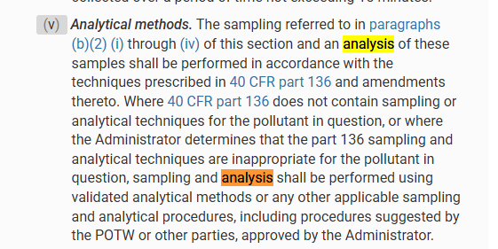
Sampling Containers/Preservations
40 CFR 403: https://www.ecfr.gov/current/title-40/chapter-I/subchapter-N/part-403

Slide 8
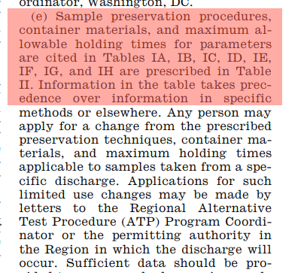
Sampling Containers/Preservations
40 CFR 136.3

Slide 9
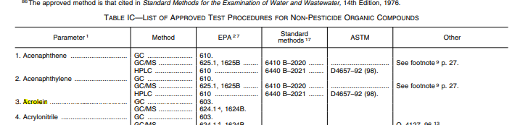

Sampling Containers/Preservations
40 CFR 136.1 Rev. 7/1/24,
  Approved Methods
  Collection Protocol

Slide 10
Sample Collection Considerations
  Getting Started With The Lab
  The lab can create a quote with the required parameters, frequency, special limits. If there are required reporting values for a permit, please request these. State limits, local limits.
    Assign a specific project name to requests.
      Groundwater sampling can apply to several events.
      Specific naming helps to ensure quote is linked to event.
  This helps to ensure consistency in sampling events
  Energy Laboratories has an option called Energy Express. This will prepopulate a COC and pre-populated sample labels.

Slide 11
Sample Collection Considerations
  Getting Started With The Lab
    Acquire a bottle set from your laboratory
  Call a Project Manager to order the supplies for your sampling project.
  If you have a stock of containers, contact the lab prior to sampling to ensure you are using the correct containers for the event.
    Some tests have flexibility in containers
    Some tests have specific requirements which MUST be adhered to.
Inspect the bottle set as soon as you receive it
  Human error sometimes occurs.
  The laboratory was not notified of an additional test.
Call your Lab with questions before sampling.

Slide 12
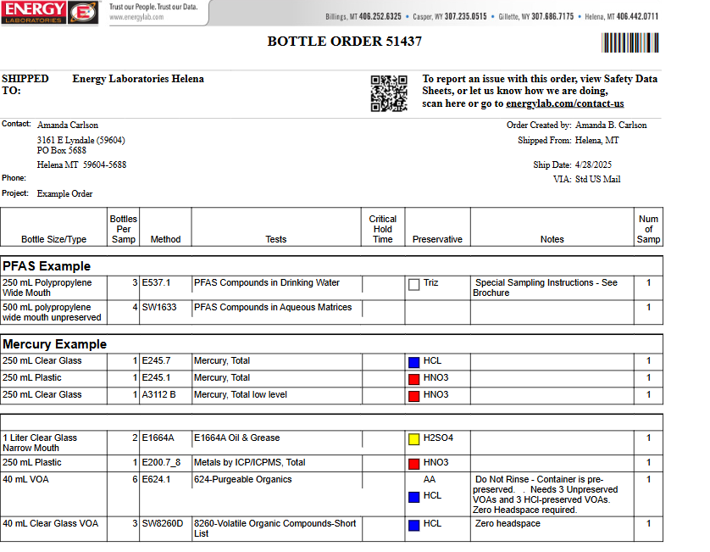

Slide 13
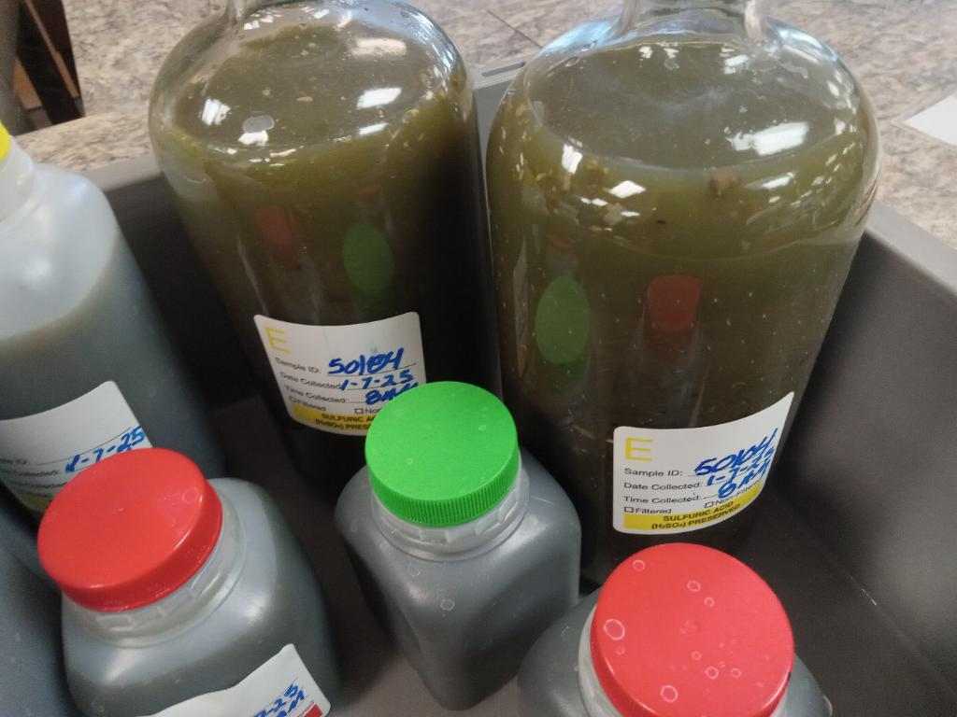
Additional Sampling Considerations
  Oil and Grease - Method requires full container used for analysis. If you expect a high value, sampling a smaller volume is recommended.
  Zero headspace methods (volatiles)

Slide 14
Additional Sampling Considerations
    Solids:
      If any special subsampling or sample handling procedures are needed (such as instructions on mixing of the sample prior to analysis, removing particles greater than a certain size, analyzing phases separately, etc.).
    Liquids
      Special precautions may be warranted if the liquid contains suspended solids and/or the liquid comprises multiple liquid phases
      Some multi-phasic liquid wastes can form an emulsion when mixed. Others, in spite of mixing, will quickly separate back into distinct phases.

Slide 15
Chain
Of
Custody

Slide 16
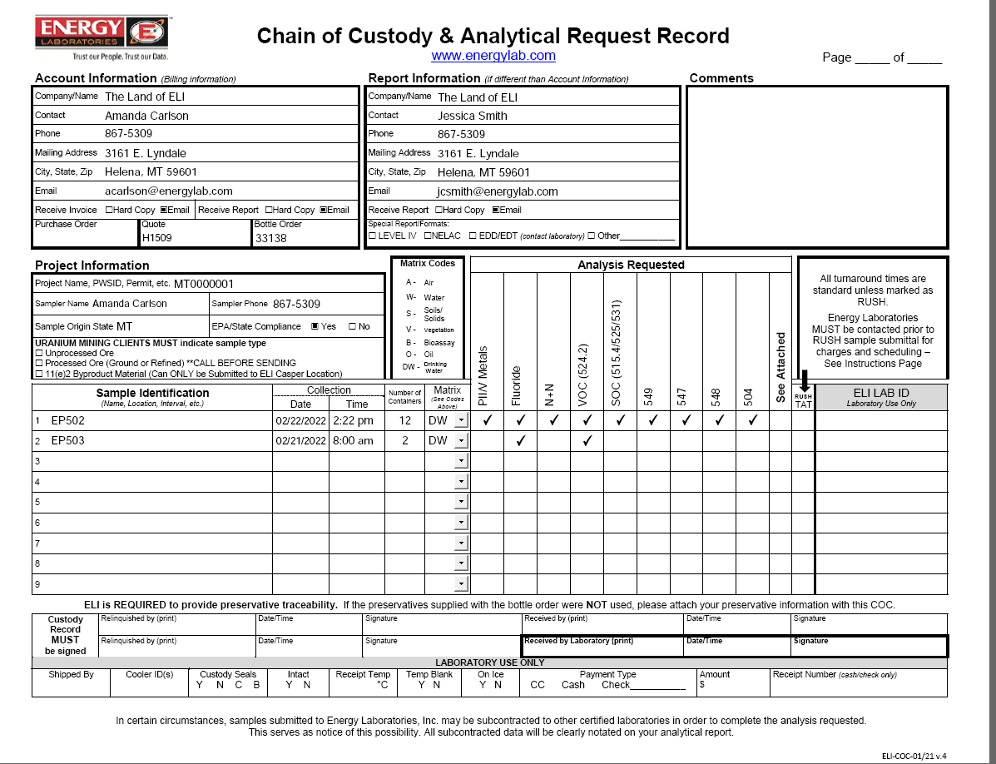

Slide 17
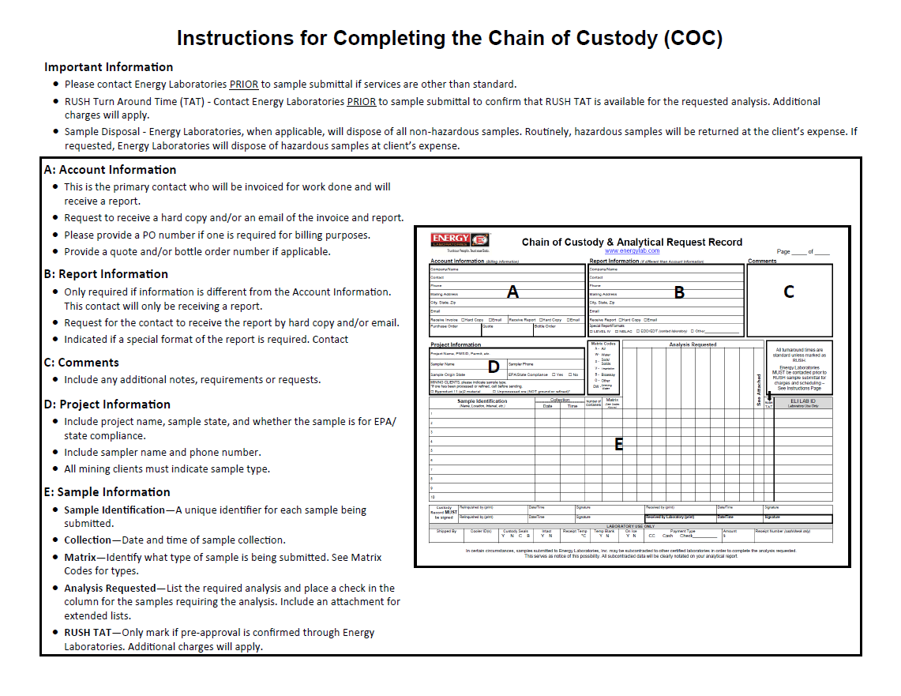

Slide 18
Additional COC Considerations
If you have a smokin hot sample, please indicate on the COC.
  Safety precautions
  Sample dilutions
  If a sample with product goes on the instrument without dilution
    Sample will need to be re-analyzed
    Sample will likely have carryover for following samples
    Worst case, instrument trap/column/lines will require replacement

Slide 19
Shipping
Best
Practices

Slide 20
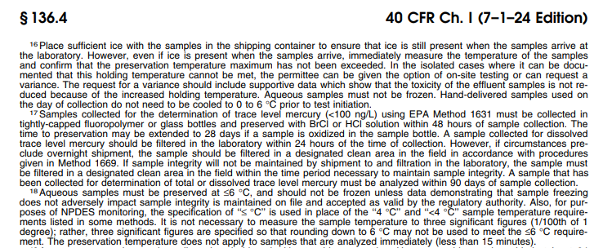
Shipping Best Practices
Use the same cooler the empty bottles came in.
Make sure there is adequate cooling during shipping.
Almost always, samples should be kept cool (<6° C or <42° F). Cool them with ice in Ziploc bags. Do NOT use blue ice packs.

Slide 21
Shipping Best Practices-Temperatures Continued
Same day delivery
  Evidence of thermal cooling should be present and documented
    From field-on ice
    There should be sufficient ice for cooling
    A sandwich-sized Ziploc of ice in a 48 qt cooler would not provide cooling for samples, especially in summer
    If after-hours drop off, ensure there is sufficient ice for overnight storage so ice is remaining in the morning
If dropping off on the weekend, please pre-arrange with lab.

Slide 22
Additional Considerations
Temperature Blanks
  Temperature blanks is a container of clean water that can be used for measuring the temperature with a probe thermometer.
  If you self-prepare a temperature blank, please make sure it is clearly labeled so this can be found in the cooler and we know what this is.
  Alternately, if a temp blank is not available, temp recorded with IR thermometer.
    IR thermometers are affected by measurement distance, ambient temperature and the surface of the object measured.
  Temperature blanks should be treated similar to samples and subjected to the same conditions.
    Do not freeze the temperature blank.

Slide 23
Additional Considerations
Most carriers to NOT store overnight in a temperature regulated facility. Usually the coolers/boxes are stored on a truck in the lot. They are subject to outside temperature extremes.
If you need to do a Saturday delivery, let the lab know to expect this.
  Staffing on the weekends is not a guarantee.
  Shipping labels must specify Saturday delivery.
  Providing tracking numbers is strongly recommended (or required).
If sampling for short hold parameters, be aware of weekends and holidays.
  Be aware of holidays.
  Be considerate when delivering short hold samples on Friday afternoon.
    Notify the lab so these are expected and analysts can be prepared.
    Understand that when received, samples are entered into the system and most tests have a set up time.

Slide 24
Analysis Specifics

Slide 25
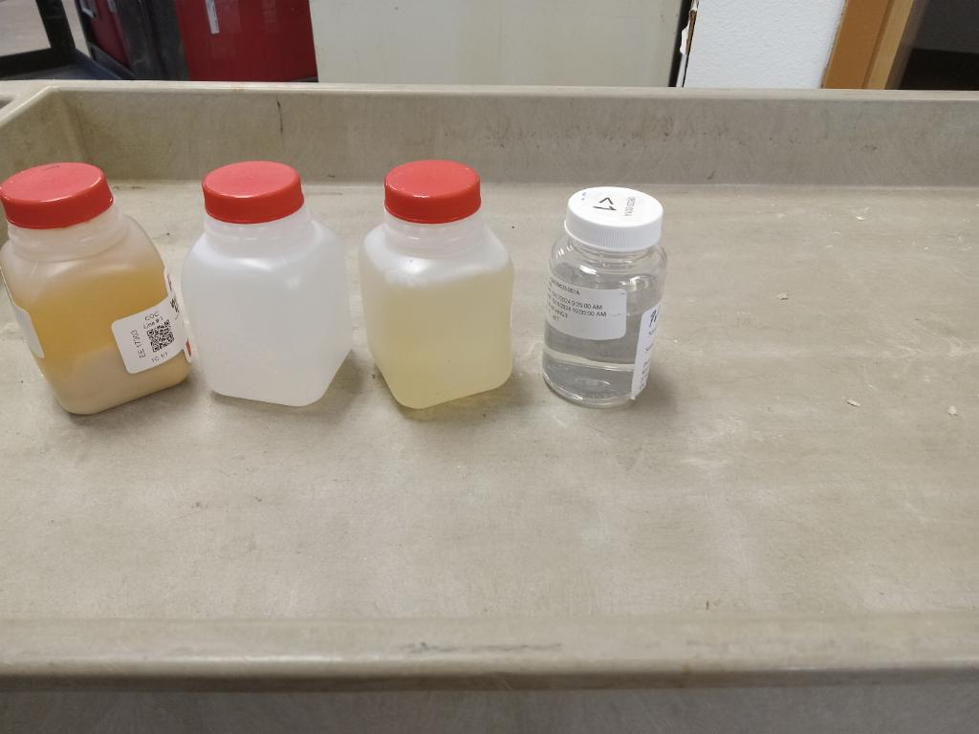
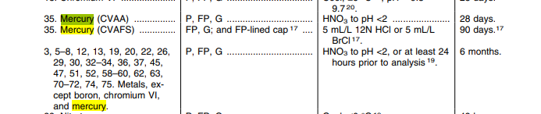

ICP/ICPMS
Collection/Preservation:

Slide 26
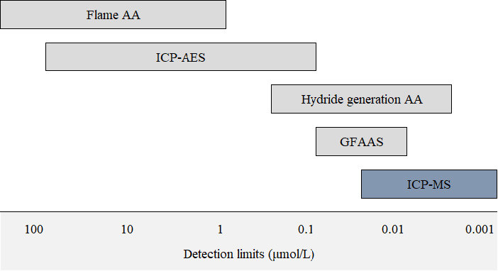
ICP/ICPMS

Slide 27
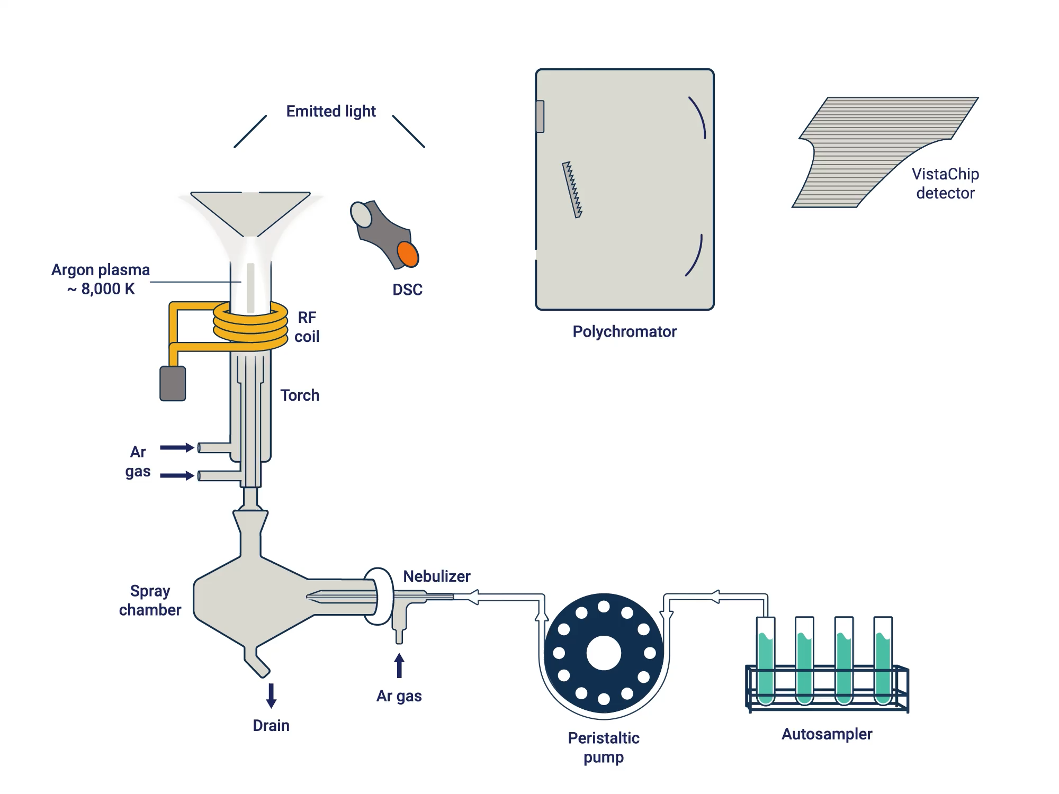
ICP-OES

Slide 28
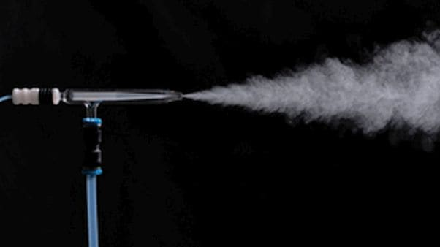
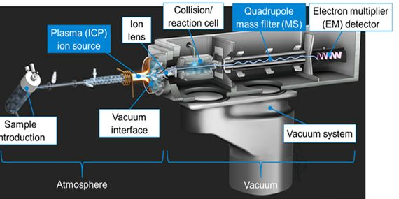
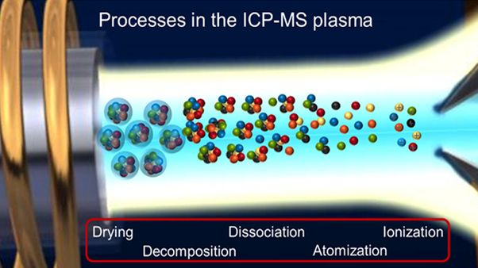
ICPMS
The main components of a single quadrupole ICP-MS instrument are:
Sample introduction system to form a fine aerosol mist from the liquid sample
Plasma (ICP) to convert the elements in the sample aerosol to ions
Interface to extract the ions into the vacuum system
Ion lens to focus the ions and separate them from background signals
Collision/reaction cell (CRC) to resolve the analyte ions from interfering ions
Mass spectrometer (MS) to filter the analyte ions by mass
The electron multiplier detector
Data processing
Agilent : What is ICP-MS? Principles & Technique | Agilent

Slide 29
ICP/ICPMS Analysis
Samples entered for requested analysis with specific analyte list
  Dissolved metals-if particulate is present samples must be digested or refiltered from an unpreserved aliquot.
    This would be past the 15 min filtration hold time.
    Some samples do form precipitate
    Filter breakthrough
  Total metals-if preserved in the lab, must be held for 24 hrs then preservation verified.
  Digest with an approved digestion method
  Analysis on ICP or ICPMS

Slide 30
ICP/ICPMS Analysis
Reruns:
Failing QC for specific analyte(s)
High TDS matrix
  Multiple dilutions may be required to capture a large list and reporting limit requirements
Interferences
  ICPMS
    Collision mode: Pressurized with helium. Ions collide with He. Collision rates lower the energy the polyatomic ions exit than analyte ions. The low energy ions are rejected from ion beam minimizing the interference.
    Reaction Modes: Cell is pressurized with a reaction gas. Gas selected is based on reaction chemistry with the interfering ion and analyte isotope. Resolves interferences other than polyatomic ions. This does have the potential to create new interferences.
    Triple Quadrupole ICP-MS

Slide 31
ICP/ICPMS Analysis
Interferences
  ICP
    Spectral Overlap-Either an interfering element directly shares an emission line with one or more target elements. May be insignificant, or may be significant. At what concentration does this become significant?
      Perform a study at a minimum annually.
    Interelement Correction factors
    Line selection
      Determine sensitivity required
      Precision
  Matrix effects
    Internal standards compatible with matrix
    Does the sample potentially have the IS naturally occuring

Slide 32
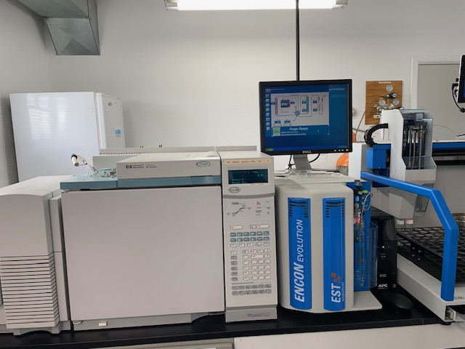
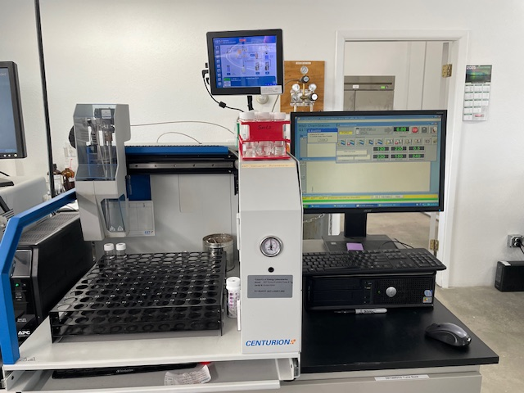
GCMS Analysis

Slide 33
Analyte Lists Lists
For 8260/624.1 analysis, short list/long/btex list refers to list of analytes.
  Difference in price
  Long list includes additional, unpreserved vials for acrolein, acrylonitrile, 2-CEVE
  Short List-50 Analytes
  Long List- 73 Analytes
  Additional analytes
    Additional analytes not part of a “routine” list but may be available.
    May have alternate preservation requirements
    Availability at a lab is not guaranteed.
      Allyl Chloride
      Cyclohexane
1,2,3-Trichlorobenzene
1,2,4-Trichlorobenzene
1,2,4-Trimethylbenzene
1,2-Dibromo-3-chloropropane
1,3,5-Trimethylbenzene
2-Chloroethyl vinyl ether
2-Hexanone
Acetone
Acetonitrile
Acrolein
Acrylonitrile
Carbon disulfide
Hexachlorobutadiene
Iodomethane
Isopropylbenzene
Methyl isobutyl ketone
n-Butylbenzene
n-Propylbenzene
Naphthalene
p-Isopropyltoluene
sec-Butylbenzene
tert-Butylbenzene
Vinyl acetate

Slide 34
GCMS Analysis
Samples collected in a 40mL glass vial, zero headspace. If chlorinated, ascorbic acid must be in the vials prior to filling.
  Most analytes HCl preserved
  Some analyzed unpreserved
  Must have zero headspace
Surrogate is added to the vial
25mL is subsampled via autosampler and transferred to the purge and trap.
Helium is purged through the sample for a set time.
Purged analytes are collected on a trap.
Trap is rapidly heated and desorbed onto the GC column.
GC column is heated with a temperature program which elutes the analytes at specified times.
Analytes are detected/evaluated based on retention time and spectral profile.

Slide 35
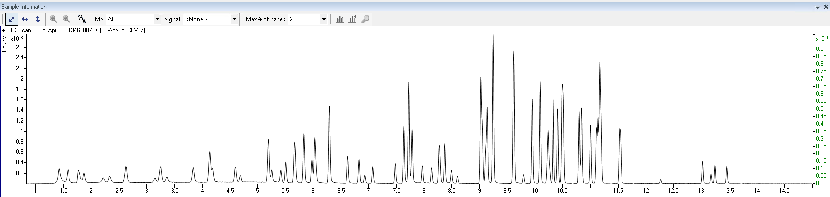
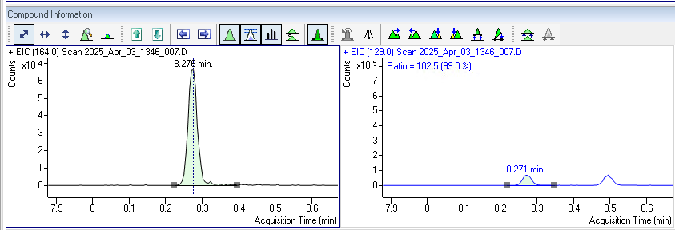
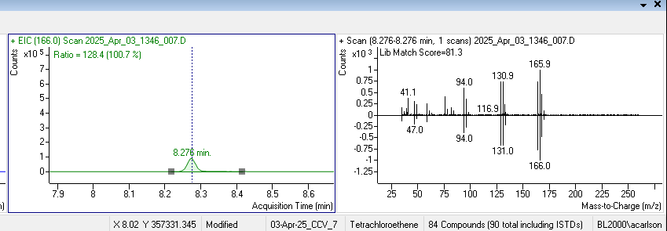
GCMS Analysis

Slide 36
GCMS Analysis
Limitations
  Matrix
    May require dilutions
    pH adjustment cannot be verified until after analysis. Hold times are based on preservation requirements.
    Calibrated to ppb concentrations. Same samples may have ppm level concentrations.
    Water soluble analytes have higher reporting limits.
    Non-target analytes can cause significant interference.
  Limited linear range

Slide 37
Method Defined Parameters
Method Defined Parameters are physical or chemical properties which are determined with specific methods used to evaluate whether the materials comply with RCRA Subtitle C regulations.
What this means:
Certain methods MUST be analyzed as written in the method protocol and labs cannot deviate. Example methods are TCLP (SW-846 1311) and Method 1664 (n-Hexane Extractable Material).

Slide 38
Laboratory Quality Control-How much QC?!?!
2022 | Metals-ICPMS (200.8/6020) | Metals-ICP (200.7/6010B) | 8260
SAMP | 57.97% | 36.41% | 58.21%
CCV | 6.99% | 10.0% | 8.21%
LCS/LFB | 2.6% | 4.89% | 6.11%
MB | 3.57% | 4.31% | 6.00%
MS/MSD | 5.9% | 5.38% | 5.1%
Other QC | 22.97% | 39.01% | 16.37%
Total # in LIMS | 74827 | 57676 | 7861
Run time / sample | ~2 min | ~4 min | ~32 min

Slide 39
QA/QC Parameters: Definitions
Definitions/Naming Conventions of QA sample types come from a variety of sources
  Analytical Methods
  Various regulatory programs
    SW-846
    Clean Water Act
    Safe Drinking Water Act
  Various certification agencies
    The NELAC Institute
    Department of Defense
What does this mean?
  Often the purpose of a QC element is similar, but could have several different names.

Slide 40
Data Validation
Analytical data validation is the systematic review of laboratory data deliverables and can help identify laboratory and field sample analytical uncertainty.
Data usability assessment also encompasses field sampling uncertainty including overall sampling plan, sampling processes and conditions during sampling.

Slide 41
Data Validation
  Two types of QC
    Preparation Batch QC-Generally pertain to samples requiring extraction or digestion
    Instrument-Related QC
  LCS/LFB/ICV is used to verify the laboratory can perform the analysis in a clean matrix.
    Method specific basis, control limits are statistically calculated for certain QC parameters (LCS, MS/MSD)
    High LCS indicates a potentially high bias. If samples are ND, no action required.
    Low LCS indicates a low bias. Results should be qualified.
    For analysis with a large number of analytes, it is statistically likely that a few elements will be outside control limits. This may not indicate the system is out of control. TNI allows for marginal exceedances before corrective action is required.

Slide 42
Data Validation
The Method Blank shall be considered to be contaminated if:
the concentration of any target analyte (chemical of concern) in the blank exceeds 1/2 the Reporting Limit or is greater than 1/10th the amount measured in any associated sample
ii) the concentration of any common laboratory contaminant in the blank exceeds the LOQ;
b) if a Method Blank is contaminated as described above, then the laboratory shall reprocess affected samples in a subsequent preparation batch, except when sample results are below the LOD. If insufficient sample volume remains for reprocessing, the results shall be reported with appropriate data qualifiers.

Slide 43
Data Validation
  MS/MSD is used to indicate the efficiency of the method in analyte recovery.
    MS/MSD recoveries may not be meaningful if the sample analyte amount is large relative to the amount spiked
    Information from MS/MSD is sample/matrix specific and would not be used to determine validity of entire batch.
    MSD may provide a usable measure of sample homogeneity.
    MS/MSD qualification on batch samples should ONLY apply if the samples are considered sufficiently similar.
      Aqueous: pH, Conductivity, TSS, Chlorine, TOC, Alkalinity
      Soils/sediments: Organic Matter, Texture, Alkalinity
      Fish: fillets, whole fish, liver plug. Oily fish

Slide 44
Data Validation
Items which would require additional follow-up:
  CCV/LCS/ICV recoveries which are significantly outside of method limits (0% recoveries or >200% recoveries).
  Surrogate recoveries outside acceptance limits, without appropriate qualification.
    If chromatograms are included, verify on chromatogram if significant matrix interference is present
  Significant outliers in field QC
  Missing QC where appropriate (MBLK)
  Dates/times of QC relative to sample analysis
  Date/time collection < Date/Time Receipt < Date/Time Analysis and make sense for how samples were delivered.
  Inappropriate dilutions.
Items worth noting:
  Documented clean-up procedures on the sample
  Method deviations

Slide 45
Data Validation
Check
  Sample receipt documentation
    Include any deviations and corrective actions taken in relation to sample receipt
    For ELI this also includes “Standard Reporting Procedures” notes
  Case Narrative
    This can document issues with samples, QC, any additional procedures required or changes requested after sample receipt.
    Revision notes may also be included here.
  Footnotes on samples related to that specific analysis
    Aqueous VOC pH is documented if >2 as a footnote for that sample.
    If appropriate, subsequent H Flag documentation is added.

Slide 46
Wrap up
Recently completed a process map of samples traveling through the lab.
  There are approximately 45 touchpoints on a sample/workorder as it goes through the laboratory process.
Energy Laboratories is currently working on evaluating our strengths, weaknesses and what is important to our clients.
Data Usability starts with sampling and encompasses all touch points.
Communication and clear documentation are essential to successful sampling and analysis.

