Slide 1

Crucial
Conversations
Presented by: Leah Braun
Chief of Staff, City of Rapid City
Notes:
Handouts – Explain
We only have an hour so this is truly a primer
We can’t have it all but we can nurture what we want most
4 P’s – patience, persistence, perseverance, perspiration

Slide 2
“Our work, our relationships, and our lives succeed or fail one conversation at a time. While no single conversation is guaranteed to transform a company, a relationship, or a life, any single conversation can. Speak and listen as if this is the most important conversation you will ever have with this person. It could be. Participate as if it matters. It does.” ~ Susan Scott, Author of Fierce Conversations

Slide 3
Objectives
The impact of crucial conversations
Dialogue dissected
7 Principles of Crucial Conversations
The skills of Crucial Conversations
Putting it all together
“Our lives begin to end the day we become silent about things that matter.” Martin Luther King Jr.

Slide 4
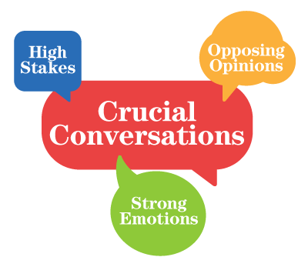
Notes:
We want to:
Speak persuasively, not abrasively
Foster teamwork
Address pain points
Resolve disagreements

Slide 5

Dialogue
Definition
Purpose
The free flow of information between 2 or more people
To fill the pool of shared meaning
The better the pool is filled, the better the outcome
Notes:
E.g. Someone is late but is a rock star employee. We’re focusing on the late behavior and not allowing them to think that we’re implying laziness, therefore laziness at work too.

Slide 6







7 Crucial Conversation Principles
START WITH THE HEART
LEARN TO LOOK
MAKE IT SAFE
MASTER YOUR STORIES
STATE YOUR PATH
EXPLORE OTHERS’ PATH
MOVE TO ACTION

Slide 7
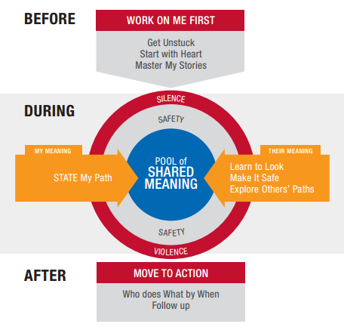
Notes:
Before: Share truth
During: Act nobly
After: Dare to do the right thing

Slide 8
What are some examples of crucial conversations?
Why do we avoid them?
Notes:
These are usually not planned in advance but if you can plan it, it will likely go better.
A bomb could be dropped on you. You want to be ready! Or a convo. Can turn crucial all of the sudden.
A subordinate or coworker who behaves offensively or makes suggestive comments
Giving an unfavorable performance review
A subordinate or coworker who is rude to customers
Asking a friend to repay a loan
You feel like your boss is micromanaging you
Asking a roommate to move out
Resolving custody or visitation issues with a former spouse
Working with a rebellious teen
Talking to a team member who isn’t keeping her commitments
Confronting a loved one about a substance abuse problem

Slide 9
The consequences of not having hard conversations
Affects on you personally
Perpetuation of the problem
Giving control to the other person
Not living up to the culture, standards, values, etc.
Impact on fellow employees, family members and customers
Notes:
Give 2 examples – someone steps in front of me and says, “Let’s talk about this later over drinks.” And then after feedback about being late, “Isn’t it interesting that the higher the position, the less critical feedback people get?”

Slide 10
How to determine if a behavior is leading to a crucial conversation
CPR!!
  Content issues (Bob is late)
  Pattern issues (Bob is late almost every day lately)
  Relationship issues (Others in the shop are getting annoyed and complaining about Bob’s lateness)
“The single greatest problem in communication is the illusion it has taken place.” George Bernard Shaw

Slide 11

Don’t settle for the ‘Fools Choice’
Having a difficult conversation OR keeping the relationship strong
You can have BOTH
“Wise men speak because they have something to say; fools because they have to say something.” Plato

Slide 12

#1. Start with the heart
What do you really want?
  For yourself
  For the other person/people
  For the organization
We do not want to…
  Be right
  Win
  Shame the other person
  Put them in their place
“Don’t raise your voice, improve your argument.” Archbishop Desmond Tutu
Notes:
The first thing to degrade is not our behavior but our motives (but behavior isn’t far behind) – e.g. Front porch Coalition meeting w/ former ED
Examine our motives
Introduce Bob. Bob is a 6-month employee and is a rockstar but…he’s been late more and more these past weeks. How do we start with the heart w/ Bob?

Slide 13
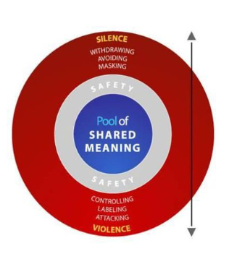
#2. Learn to look
For signs that the conversation isn’t going well
For the signs of silence and violence
Be aware of your own style under stress
If things go south, contrast
It’s okay to take a time-out too
Notes:
Your own style – do you withdraw? Change the subject? Make jokes
Contrasting: “What I want is for you to be on time. I don’t want to make you feel bad or cause you to think you’re not doing a good job.”
Bob – let’s say you pull him aside and say, “Bob I’ve noticed you’ve been a lot. What can we do to correct the problem? Or I need you to be on time because it’s impacting the team.”
Silence means Bob won’t engage in the convo or is making jokes about it or says, “Why don’t you pay attention to Julie. She’s watching videos on her phone all day”. Violence means he spouts off about having a lot going on and you’re picking on him and he’s going to report you to HR for harassment.
Example on pg. 52 of workbook – “How do I look?”
Your own style? ASSESSMENT!

Slide 14
#3. Make it safe
Make it safe (emotionally and physically)
Decide if mutual purpose or respect are at risk
  Purpose in the ‘entrance condition’ and respect is the ‘continuance condition’
  Does the other person know you have her best interests in mind?
Apologize if appropriate
Do what it takes to get back into mutual purpose and respect mode
“The void created by the failure to communicate is soon filled with poison, drivel, and misrepresentation.” C. Northcote Parkinson
Notes:
Bob – purpose can be establishing that you’re concerned and need to address something. Respect means watching your words and paraverbal comm. If you say, “You need to get your butt out of bed earlier,” you’re implying laziness and not showing empathy for what he has going on.
What could the couple from “How do I look?” have done?
Remember psychological safety?

Slide 15
#4. Master your stories
What story are you telling yourself about the situation and other person? Is it the full story? Is it true?
Three ‘clever’ stories
  “It’s not my vault” (VICTIM)
  “It’s all your fault” (VILLAIN)
  “There’s nothing I can do” (HELPLESS)
“I am always at a loss to know how much to believe my own stories.” Washington Irving
Notes:
Example on pg. 134 of workbook – “The elevator”
Victim: I’m tired of people making me late!
Villain: He should have hurried. I don’t like him anyway; I heard he always tried to put people out.
Helpless: I can’t save everyone. This is just how it goes.
Victim: I didn’t have time to wait. I’m tired of people making me late for work.
Villain: He should have hurried. I don’t like him anyway.
Helpless: I can’t save everyone. I have my own things to worry about.

Slide 16
Edit your stories
1. Turn the VICTIM into ACTORS
  What am I pretending to not notice about my role in the problem?
2. Turn the VILLAINS into HUMANS
  Why would a reasonable, rational and decent person act this way?
3. Turn the HELPLESS into ABLE
  What do I really want? How would I act if I really wanted it?
"25 years of research with 20,000 people and hundreds of organizations say individuals who are most influential are those who master communication.“ Crucial Conversations
Notes:
Break?
Sea to Shining Sea

Slide 17





#5. State your path
(Share your story)
Share
Tell
Ask
Talk
Encourage
Share your facts
Tell your story
Ask for the other’s path (perspective)
Talk tentatively
Encourage testing
The ‘What’ Skills
The ‘How’ Skills
Notes:
1st three are the ‘what skills’ – what you say
2nd two are the ‘how skills’ – how you say it
Talk tentatively – share as your story rather than absolute gospel truth; avoid speaking in absolutes, soften the message a bit, choose words carefully, watch body lang and paraverbal comm, strike balance between humility and confidence, I and we statements are good
Encourage testing – say, “What am I missing?” or “Maybe I’m wrong here” Be persistent!
Example:
Share – “I saw your resume on the printer.”
Tell – “I’m curious about what this means and I’m concerned that you’re planning to leave.”
Ask – “Can you tell me what you’re planning?”
Talk tentatively – share as a story rather than hard facts. Choose words carefully. Could have said, “What the heck is your resume doing on the printer?” or “Looks like someone wants to quit rather than be fired!” Soften the message. “Maybe you told me you were teaching a class on resume-writing and I forgot?”
Encourage testing – be persistent if they try to change the subject; ask, “What am I missing?” and “Maybe I’m wrong?”
What Skill #1: Share the Facts
Facts set the stage for all sensitive conversations. Start with the facts alone (which are observable), not your emotion-driven story (your conclusions). For example, a hotel receipt in your husband’s name is a fact — you can see it. Your belief about why he visited the hotel (absent his explanation) is a conclusion. In order to use the Crucial Conversations “state my path” plan, you have to know the facts.
Starting with your worst-case scenario or conclusion creates a self-fulfilling prophecy. When you blurt out your conclusions, it’s ineffective. You expect bad results and get bad results. Or you hold the story inside because you feel it’s too risky to share — tension builds up and you blow up, getting the bad results you feared.
Starting with facts avoids these problems. Here’s why:
Facts are the least controversial: They provide a safe beginning. Facts are objective and noncontroversial while conclusions are highly subjective and controversial.
Facts are the most compelling: Starting with factual observations is the best way to get others to listen. You want to give others a basis for understanding how a reasonable person could think what you’re thinking. You’re not trying to win but to get your meaning added to the pool and to get a fair hearing.
Facts are least likely to offend: Because they’re neutral observations, facts are the least likely to offend or put others on the defensive. Starting with your story, on the other hand, could surprise and insult, and consequently derail dialogue.
It’s important to begin at the beginning: Let others see the experience from your point of view, starting with your facts. When you offer your conclusions (your story), they’ll understand why.
Once you accept this first step, you’ll be able to move onto sharing your truth with the crucial conversations state my path plan.
What Skill #2: Tell Your Story
If you simply mention the facts, the other person may not understand the implications. For example, if you tell an employee, “I noticed you had company software in your briefcase,” they may not understand that you’re talking about a potential policy violation. You have to follow-up that observation with your conclusions.
It’s the combination of facts plus the conclusion there’s a problem that requires face-to-face discussion. State my path in crucial conversations lets you do this. When you tell your story:
Take the risk: When you move from the facts to your conclusions, others can become defensive. But it’s necessary to take the risk.
Be confident: It takes confidence to share a potentially upsetting story. However, if you’ve objectively examined the facts, you’ll come to a reasonable conclusion that deserves a hearing. You can be confident in adding important, though controversial, meaning to the pool.
Be selective: Don’t just unload a pile of negative conclusions. Revise your villain story, so you can start in a non-threatening way: “My first reaction was to oppose your recommendation, but after thinking about it I realize I need to know more…”
Be alert to safety problems: As you share your story, watch for signs that others are feeling threatened. If people get defensive, restore safety by contrasting what you don’t want and what you do want. But don’t minimize your message — be confident enough to speak your mind.
What Skill #3: Ask For Others’ Paths
Remember that the key to sharing controversial ideas is to blend confidence and humility. State my path in crucial conversations requires your self-awareness. Express confidence by sharing our facts and stories clearly. Then, express humility by asking others how they see it. Encourage them to express their facts, stories, and feelings. Listen closely and be willing to rethink your story as more information is presented.
How Skill #4: Talk Tentatively
You’ll get people to listen if you describe both your facts and stories in a tentative, non-dogmatic way. Speaking tentatively means telling your story as a story, not presenting it as an incontrovertible fact. For example, start with phrases indicating you’re sharing an opinion, not asserting a fact: “In my opinion…”, or “I’m beginning to wonder whether…” (rather than, “The fact is…” or “It’s obvious to me that…”).
Speaking tentatively also means sharing in a way that shows confidence in your conclusions, but that also suggests you’re open to challenges.
You soften the message because you’re trying to add meaning to the pool, not force it on people. If you’re overly assertive, your information won’t be accepted (won’t make it into the pool). The “state my path” Crucial Conversations plan is dependent on the delivery of your message, not just what you say.
In fact, when talking with people holding opposite opinions, the more convinced and forceful you act, the more resistant they’ll be. Speaking in absolutes decreases your influence. Conversely, the more tentatively you speak, the more open people become to your opinions.
Being tentative isn’t manipulative. You’re tentative because your opinions may not be totally accurate or your information may be incomplete. At the same time, you shouldn’t pretend to be less confident than you are. Just be aware that your observations and stories could be flawed.
How Skill #5: Encourage Testing
Sometimes others are reluctant to use the Crucial Conversations “state my path” plan (facts, stories, and feelings), and you need to be more encouraging. You need to make clear that no matter how controversial their ideas, you want to hear them. If they don’t feel comfortable speaking up, you can’t test the accuracy/value of your views.
This is especially important if you’re talking with someone with a tendency to move to silence (to make the fool’s choice of not saying anything to avoid risk). When others are reluctant to speak up, try these steps:
Explicitly invite opposing views. Make it emphatically clear that you want to hear their views, no matter how different. If others disagree, you appreciate it and respect them for their courage in expressing their views. You need additional information to complete your story. Ask proactively: “What am I missing?”
Be sincere: Sometimes an invitation for opposing views sounds more like a threat than sincere request: “Well that’s the way I see it; any disagreement?” Be inviting with both words and tone.
Play devil’s advocate: Sometimes you can tell people disagree, but they aren’t speaking up. To encourage sharing, play devil’s advocate. Counter your own view: “Maybe I’m wrong here; what if…?”
Persist: Sometimes, others still don’t believe you really want their opinions. They may be skeptical: maybe you’re just trying to get them to agree with you, or you’re luring them into a trap where you’ll jump on them. This is particularly true if you’re an authority figure, or if they’ve experienced this in the past. You have to press as vigorously for opposing views as you do for you own view.
Crucial conversations’ STATE isn’t easy, just like the difficult discussions you may be preparing to have. But practicing crucial conversations’ STATE can help make those conversations easier.

Slide 18
It’s all in how you say it…
01
02
03
CHANGE “It’s clear to me…” TO “I’m beginning to wonder…”
CHANGE “The fact is…” TO “In my opinion…”
CHANGE “Everyone knows…” TO “I’ve talked to a few people and…”

Slide 19
#6. Explore others’ path
(explore their story)
Ask
  “I want to know what you think about….”
Mirror
  If the other person is silent….”You seem reluctant to talk. Are you sure this is okay?”
  If the person is violent…”You seem really upset to me. What’s up?”
Paraphrase
  “I hear you saying….” OR “Do you mean….”
Prime
  Ask more clarifying questions to add meaning to the pool
“The most important thing in communication is hearing what isn't said.” Peter Drucker
Notes:
Example on pg. 178 of workbook – “The boss, Chris and Kim” OR page 189 “Mirror Mirror on the Wall”
A day in the life or empathic listening exercise

Slide 20

#7. Move to action
Remember that dialogue is not decision-making
Decide…
  What are we going to do?
  How is it done?
  Who does what by when?
Ways to reach a decision
  Command
  Consult
  Vote
  Consensus
Document and follow up!
“The best form of accountability is peer pressure.” Patrick Lencioni

Slide 21
Notes:
Review
Think of the conversations you’ve had or need to have
Review the worksheets
Concerns?
Too hard…practice
Takes too long…what’s the alternative?
Other person not cooperative…start w/ yourself. Be the change!

Slide 22
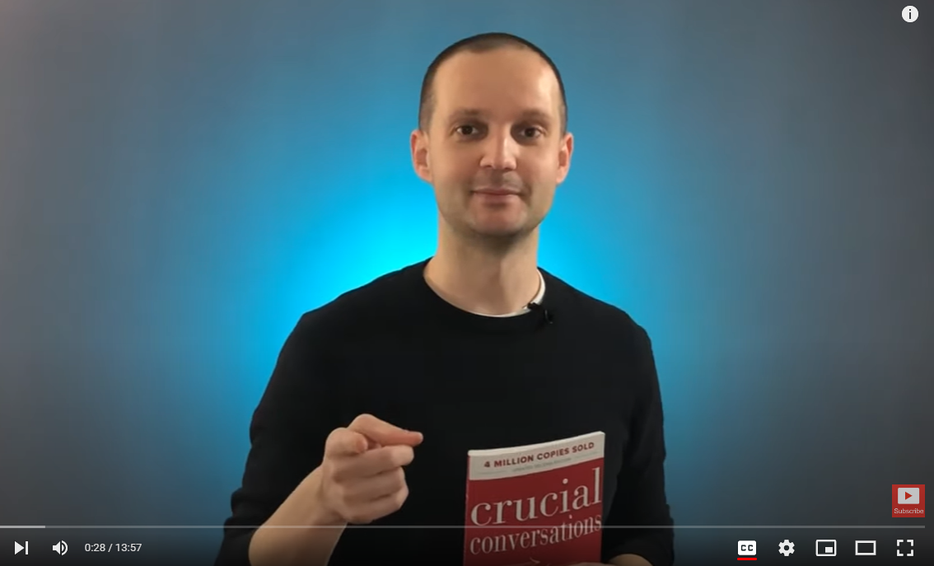
Crucial Conversations Summary & Review (Animated)
https://www.youtube.com/watch?v=Q2yG142cyNg&list=RDLVQ2yG142cyNg&index=1

Slide 23
References & Additional Reading
Crucial Conversations by Kerry Patterson, Joseph Grenny, Ron McMillan and Al Switzler
Drive: The Surprising Truth About What Motivates Us by Daniel Pink
Fierce Conversations by Susan Scott
“How to speak so that people listen” a Ted Talk by Julian Treasure 2014
How to Win Friends & Influence People by Dale Carnegie
10 Minute Guide for Motivating People by Nancy Stevenson
The Culture Code, The Secrets of Highly Successful Groups by Daniel Coyle
The 5 Dysfunctions of a Team by Patrick Lencioni
The 7 Habits of Highly Effective People by Stephen R. Covey
The 17 Indisputable Laws of Teamwork by Dr. John C. Maxwell
“10 Common Barriers of Authentic Communication at Work” by Dr. Tim Baker – www.winners@work.com

Slide 24
Thank you!
Presented by: Leah Braun
Chief of Staff, City of Rapid City
Notes:
Handouts – Explain
We only have an hour so this is truly a primer
We can’t have it all but we can nurture what we want most
4 P’s – patience, persistence, perseverance, perspiration

